Slide 1
Using the QRProblem Game Site
For Students

Slide 2

Your Instructor should have Distributed a Game Problem Document If this was distributed electronically – print it out. You should also be in a group of 1 to 7 people (3 or 4 is normally best).
Lets Suppose the
Problem number is 176

Slide 3
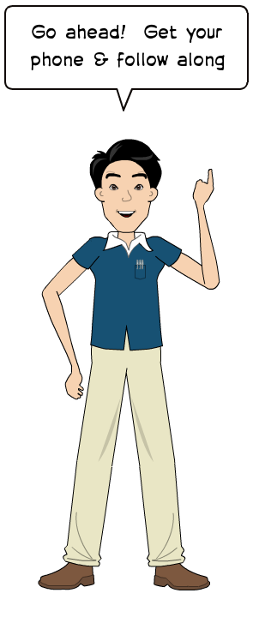
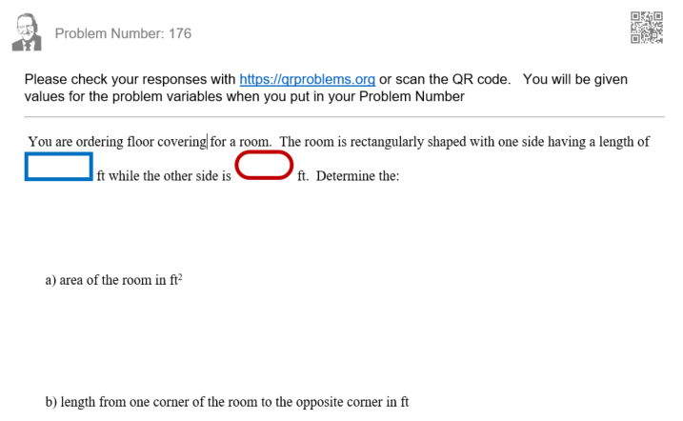

The Document would look like this:
With your phone either Scan the QR code on your problem or type Qrproblems.org in your phone's browser

Slide 4

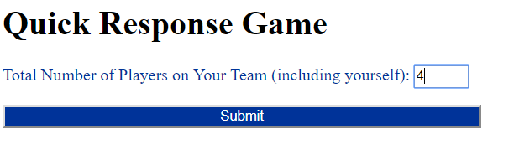
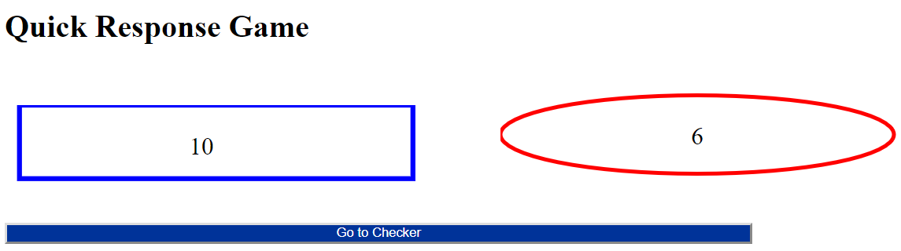

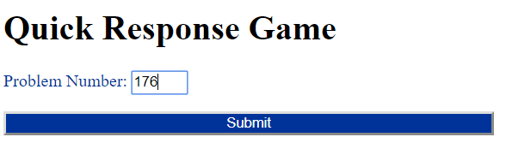

You should get this screen:
And finally:
Then:
Write these values on the sheet!

Slide 5
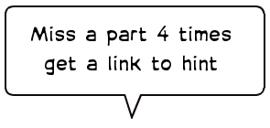
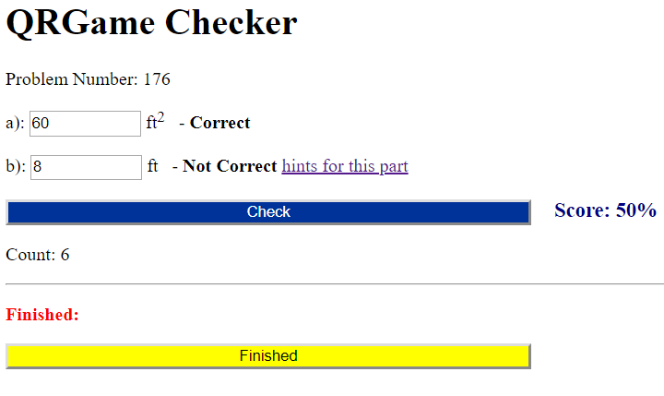

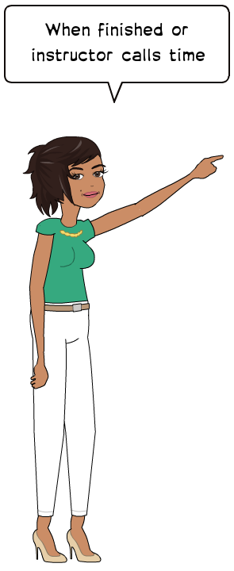
Also give and get help from your group!!

Slide 6
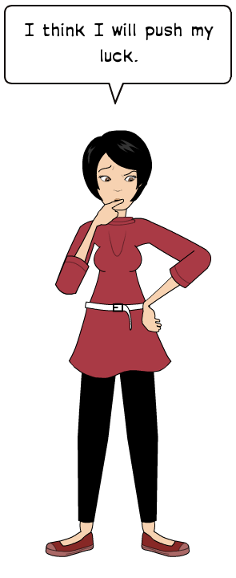
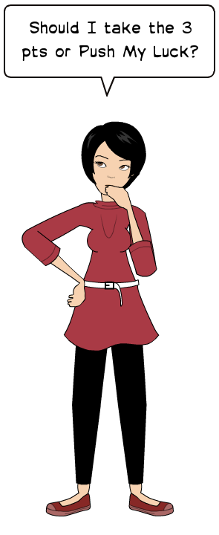
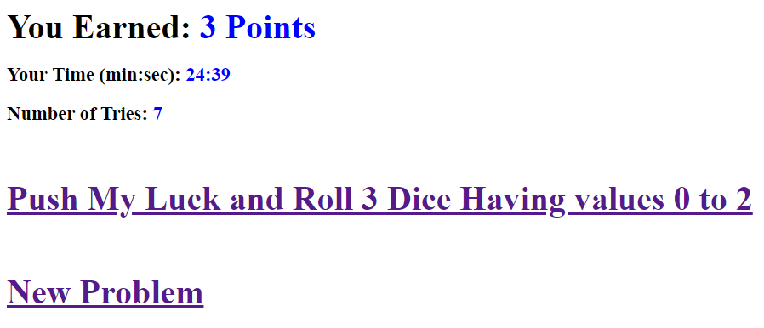


Slide 7
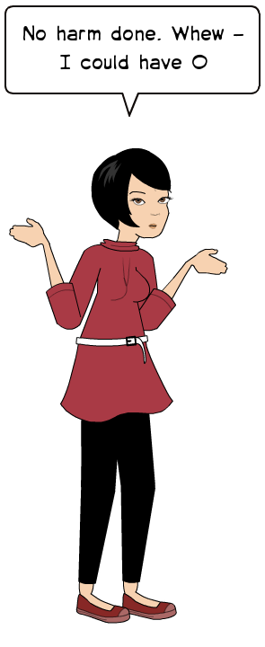
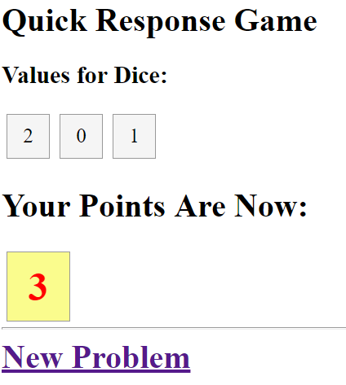

Slide 8



Report your score to your group
Group adds up scores & reports to class.
Move on to the next problem

Slide 9


